Slide 1
Rest-Services
Introduction
By
Michael Claudius

Slide 2
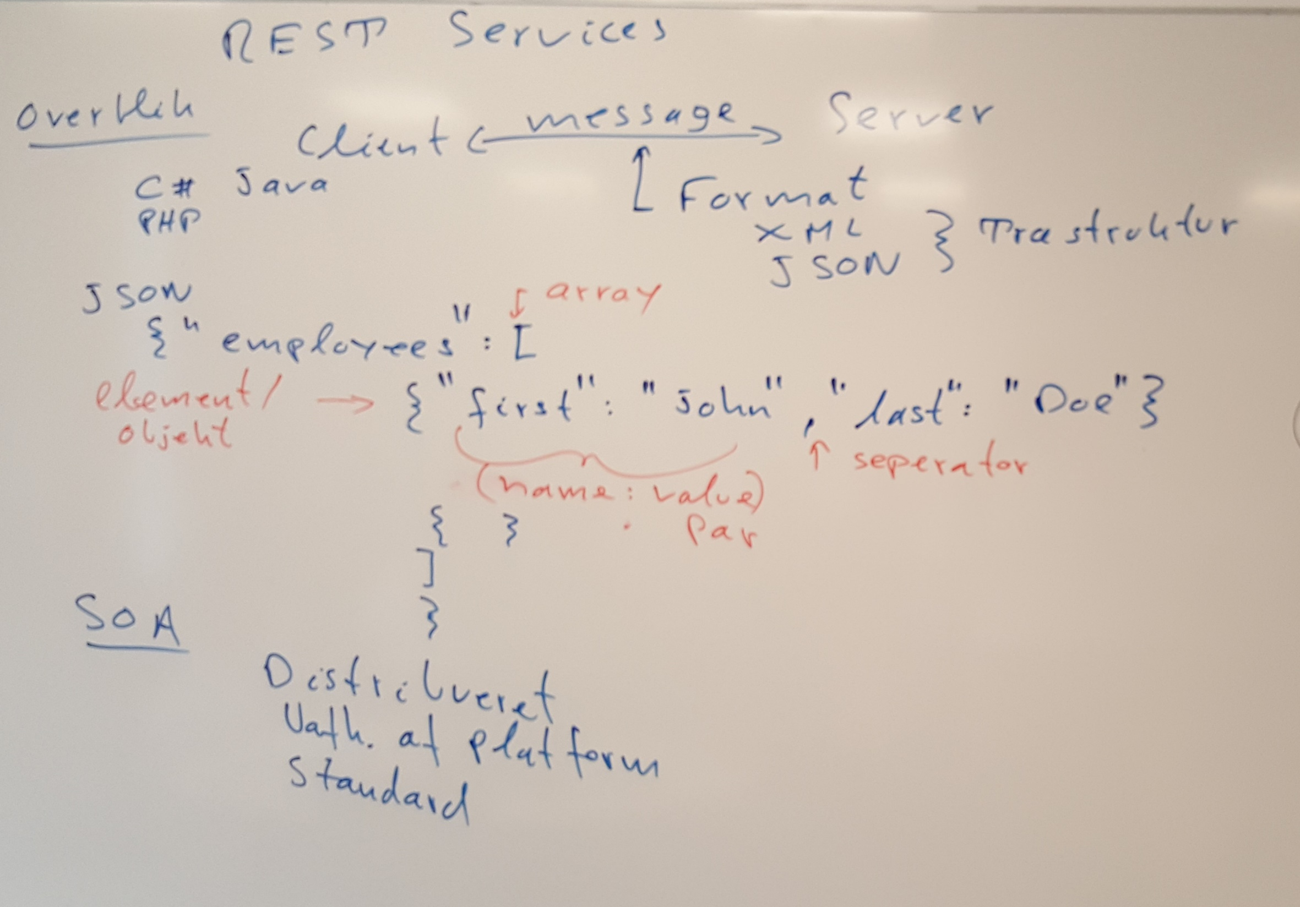

Slide 3
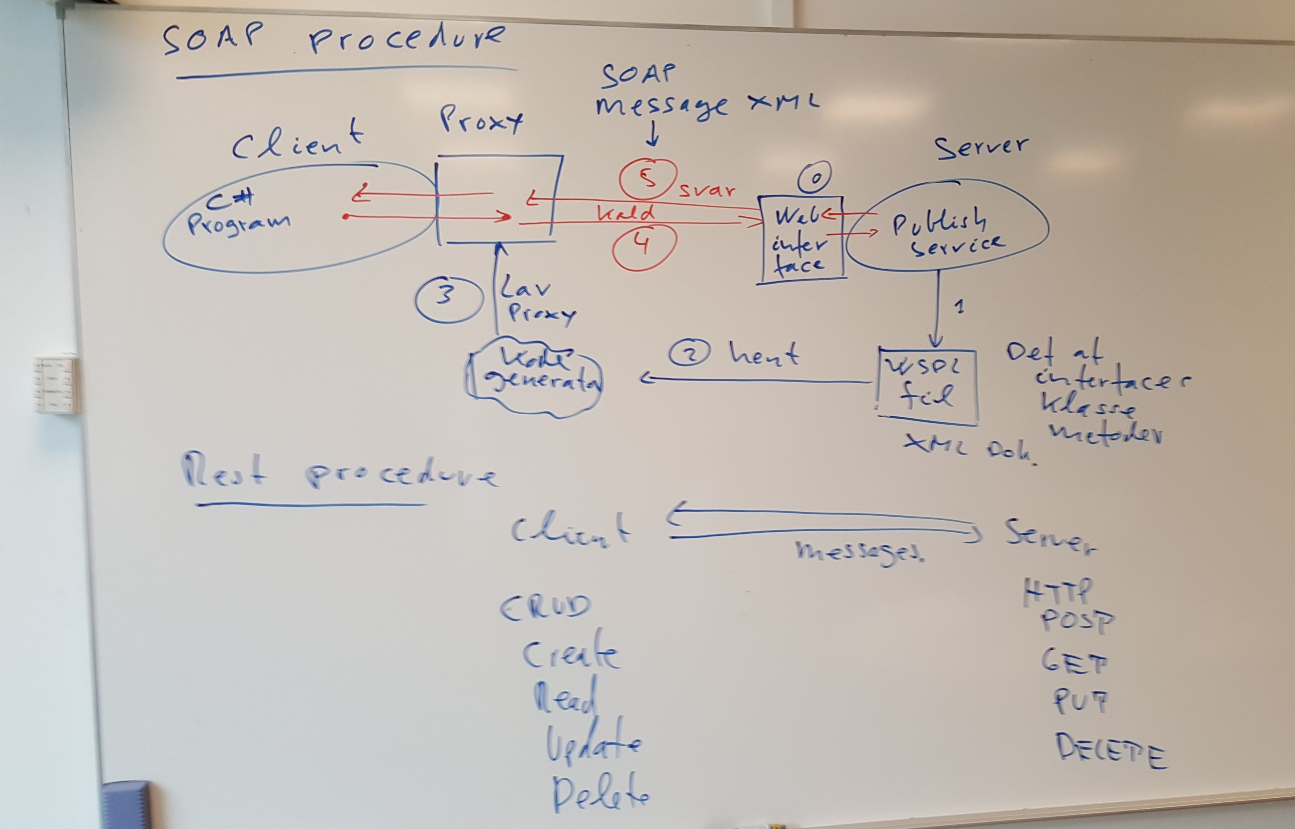

Slide 4
